Slide 1

Programming with Native Script

Slide 2
Agenda
Overview of Native Script
Pre-Requisites for Native Script
Native Script App Folders
Basic Commands of Native Script
Native Script Controls
Demo using Native Script –Android App

Slide 3

My Intro
Baskar Rao
Senior .Net Consultant with Compunnel Software Group.
https://www.linkedin.com/in/baskarrao-dandlamudi
baskarrao.dandlamudi@outlook.com
www.compunnel.com
https://github.com/baskar3078

Slide 4


Native Script - Overview
Native Script is free open source framework for building native IOS and Android Apps.
Build Cross Platform mobile apps using single code base.
Develop Mobile Apps using JavaScript , Angular , Typescript and Vue

Slide 5


Why Native Script
Web Developers with knowledge of HTML, CSS and JavaScript can use the same to develop rich native mobile applications.
Easily develop apps using existing plugins from npm [Node], Gradle [Android] and IOS Plugins.
Easy to learn and develop apps using pre-defined templates.

Slide 6



Pre-Requisites of Native Script
Prior Knowledge of HTML, CSS and any one of scripting language JavaScript , Angular, Typescript or Vue
Node.js Server, Command Line Terminal and Preferred Text IDE Editor
Android Studio, Android SDK and Android Emulator, Java SDK

Slide 7
Native Script – App Structure

Slide 8
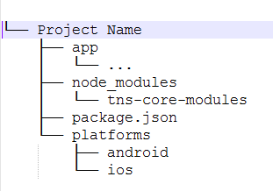
Native Script App Structure
Any Native Script app contains the below folders
Root – Project Name
App Folder
Node_Modules
Package.Json
Platforms

Slide 9
App Structure
App Folder
This folder contains all the development resources like forms, js files
Node_Modules
This folder contains application npm module dependencies. The tns-core modules folder
contains Native Script related javascript modules which can be used to develop features in the application like http calls, access files etc.
Package.Json
Details of application and the version of native script used and other npm modules used in the application.
Platforms
This folder contains platform-specific code which Native Script needs to build IOS or Android Apps. This is mostly generated code by Native Script CLI.

Slide 10
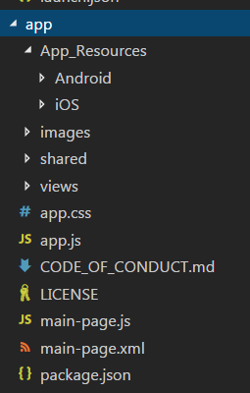
App Structure - Contd
App_Resources
This folder contains platform specific resources.
Shared
This folder contains files that needs to be shared across views
In app.
Views
This folder contains the code to build apps views. Each view is made
Up of XML File, a Javascript file and optional css file.
App.css
File contains global styles used in the app.
App.Js
This file sets up applications starting module and initializes the app.

Slide 11
Native Script CLI Basic Commands
tns create appname --template template name
The above command is used to create a native script app using
Native Script CLI.
tns build android
This command is used to build nativescript app using android platform
tns build ios
This command is used to build nativescript app using ios platform
tns run android --emulator
This command is used to build and deploy your app using android emulator
IOS related commands cannot be run in Windows OS. They can be used only in Mac.

Slide 12
Native Script Controls

Slide 13
What makes a Native Script View
Native Script View is comprised of three files.
-- ViewName.xml
-- ViewName.css
-- ViewName.js
Xml file is used to design the screen layout and screen controls.
Css file is used to mention css class specific to the view.
Js file acts as the code behind file similar to aspx.cs for an aspx page.

Slide 14
Native Script View Models
Native Script View Models are used to enable two way data flow between model and view
Native Script uses the observable module to facilitate the binding between view and model
var observableModule = require("data/observable");
The properties defined in view model can be accessed in view using the “{{ propertyname }}” syntax
<TextField id="email" text="{{ email }}" keyboardType="email" autocorrect="false" autocapitalizationType="none" />

Slide 15
Native Script Basic Controls
TextField
<TextField id="email" text="{{ email }}" keyboardType="email" autocorrect="false“ autocapitalizationType="none" />
Id – Used to define a unique identifier for the property
Text – Used to define the text which is binded to the TextField. Use of {{ }} binds it property in viewModel.
keyboardType – This is used to determine the keyboard layout. Email is used for email fields and Secure is used for password fields.
Label
<Label text="{{ name }}" horizontalAlignment="left" verticalAlignment="center"/>
Text – Used to define the text which is binded to the Label. Use of {{ }} binds it property in viewModel.

Slide 16
Native Script Basic Controls
Image
<Image src="res://logo" stretch="none" horizontalAlignment="center" ></Image>
Src field is used to load the image from resources. Native script makes sure load the appropriate image from android platform for android and ios platform for ios.
Button
<Button text="Sign in" tap="signIn"/>
Tap Property is used to mention the code behind which needs to be executed on click of the Button.

Slide 17
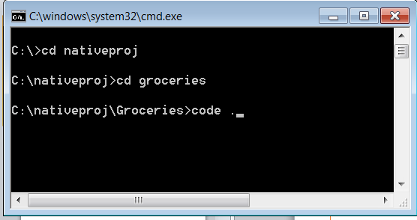
Dev Tools
Visual Studio Code
Native Script extension can be used to develop and debug NativeScript Applications.
Create a native script app using tns create app command.
Navigate to the app folder.
Enter code . Command .
Chrome Developer Tools
Chrome Developer Tools can also be used to debug NativeScript Applications.

Slide 18
Walkthrough
Demo of an existing app using Visual Studio Code
Demo livesync feature
Demo how to make API calls using Fetch Module.

Slide 19
Further Resources
www.nativescript.org
The site has good amount of documentation to get started with development.
There is an active forum which is maintained to resolve queries.
The app used in the demo has been taken from Native Script Tutorials.

Slide 20

Questions
https://www.linkedin.com/in/baskarrao-dandlamudi
baskarrao.dandlamudi@outlook.com
https://baskarrao.wordpress.com/
Thanks to the organizers of Orlando Code Camp for giving me an opportunity to present.

